Slide 1
Breweries and Beer Study
Team “Greco-Roman” Brady Arendale John Partee Steven Vazquez

Slide 2
Study Outline
Two data sets were provided with questions that needed answers.
One dataset contained information regarding beer, the other contained information regarding breweries.
The data was merged, analyzed, and plotted out.
All of this was done in R.

Slide 3
Dependencies
The following datasets and packages are required to reproduce this research
Data:
Beers.csv
Breweries.csv
These can be found at: https://github.com/vazquezs123/DATA_SCIENCE_CS01
Packages:
Dplyr
Knitr
Ggplot2

Slide 4
Beers Dataset
Beers.csv contained 2,410 rows of 7 variables, with one row of labels.
“Name” is the plain text name of the beer.
Beer_ID is a numeric identifier given to the beer, which was unused.
ABV is the alcohol by volume, as a percentage.
IBU is the international bitterness unit, a measure of bitter compounds.
Brewery_id is a numerical identifier for the brewery.
Style is the plain text explanation of the style of beer, which was unused.
Ounces is the size of the vessel of beer.

Slide 5
Breweries Dataset
Brew_ID is a serialized numeric identifier for each brewery.
Name is the plaintext name for each brewery.
City is the city in which each brewery is located.
State is the state in which each brewery is located.

Slide 6
Study Notes
The direction of this study was guided by customer provided questions.
The following slides are in chronological order, as analyzed.

Slide 7
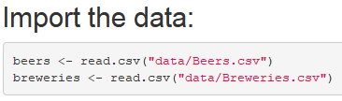
Initial Input

Slide 8
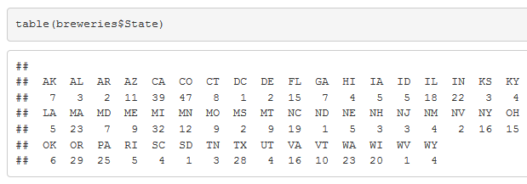
Question 1: How many breweries are in each state?
* Colorado in lead with most breweries, while all states have at least 1 brewery.

Slide 9
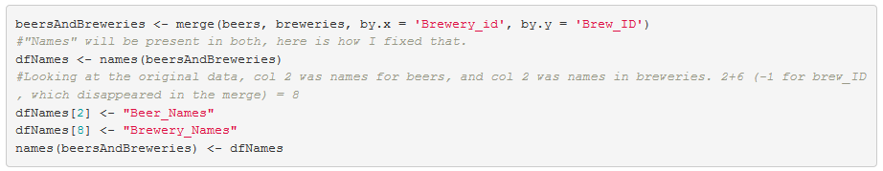
Merge the datasets:
One minor variable name change had to be made to avoid a merge conflict.
“name” was a duplicate variable found in both datasets.
Beer_Names and Brewery_Names are the new names.

Slide 10
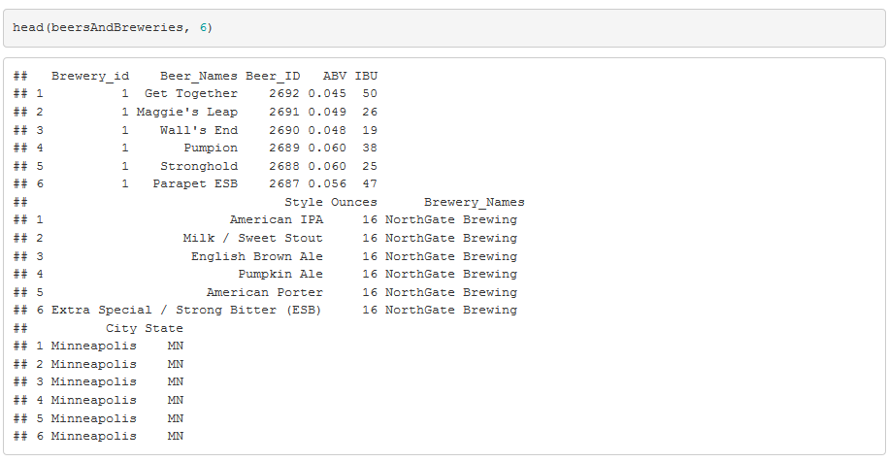
Check that it worked:
We’ll check the top and bottom. Top 6 lines:

Slide 11
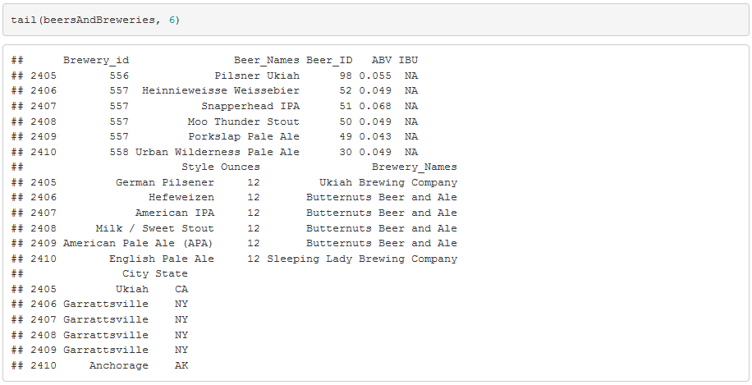
Check that it worked:
We’ll check the top and bottom. Bottom 6 lines:

Slide 12
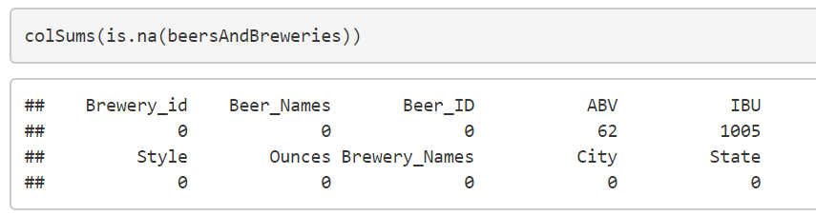
Question 3: How complete is this data?
We are tasked with finding some summary statistics on this data, so noting the completeness of the set is essential. There are 62 missing values in ABV and notably 1005 missing IBU values, see below.

Slide 13
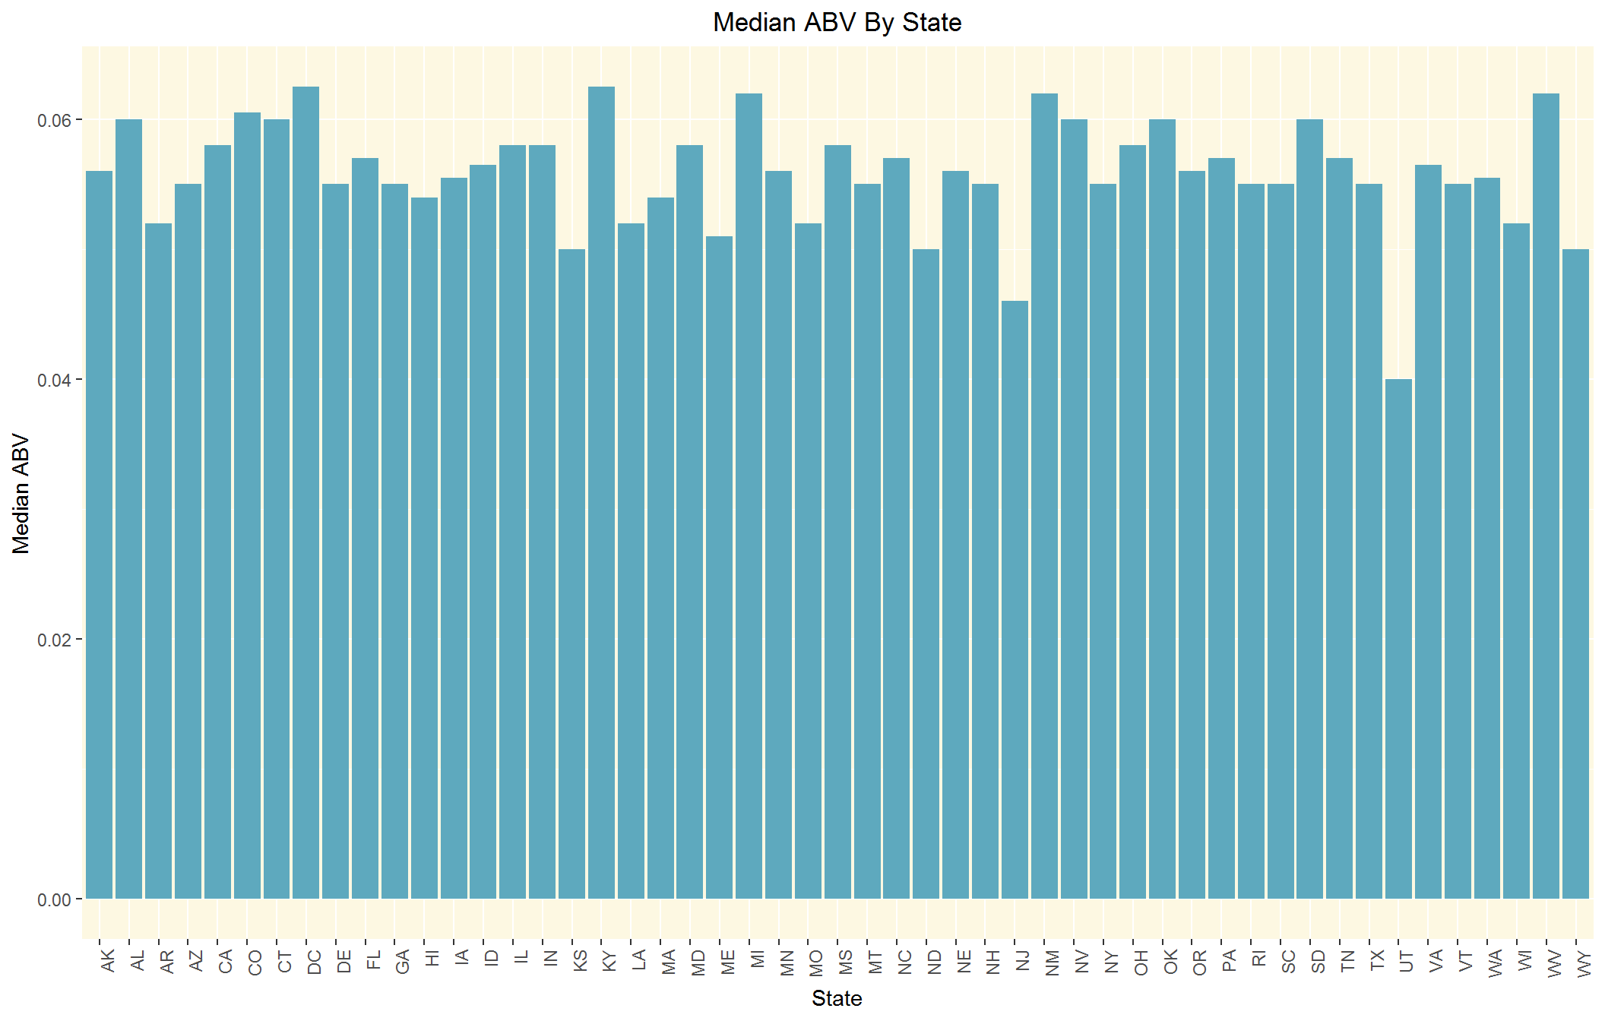
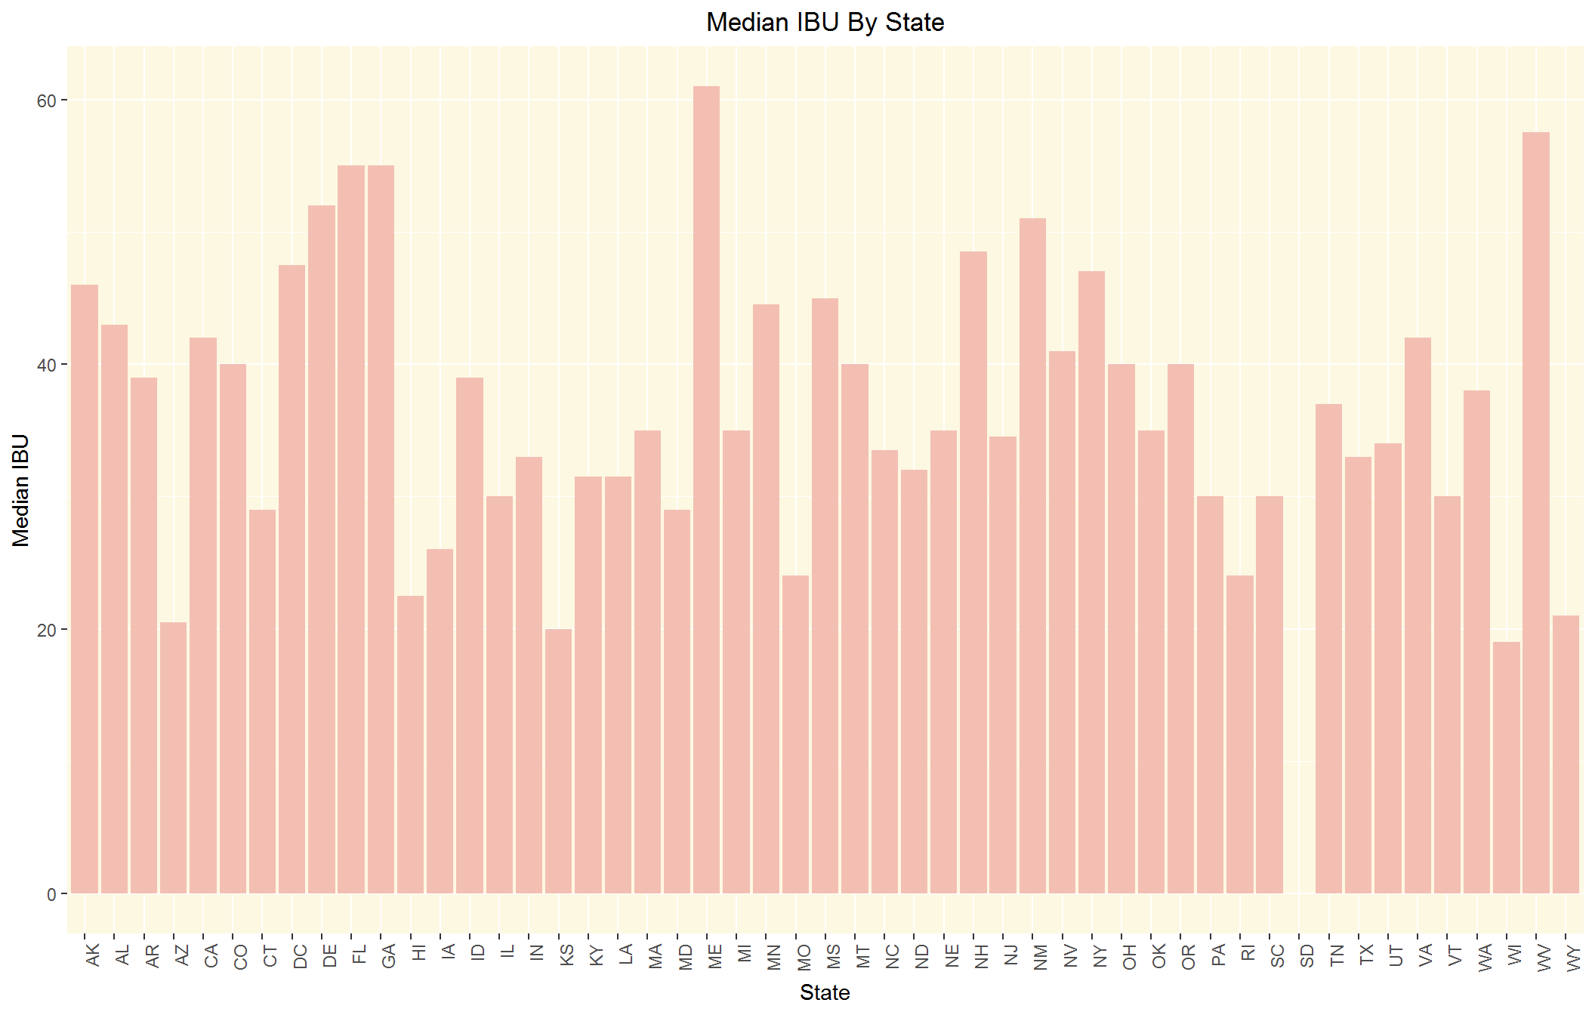
Question 4: IBU and ABV by State

Slide 14
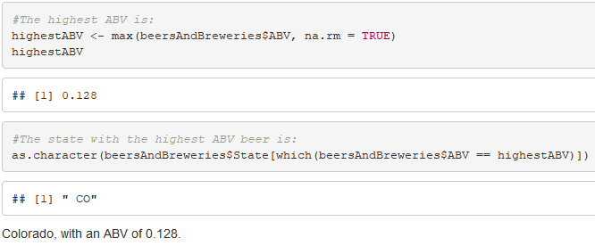
Question 5: Which state has the highest ABV?

Slide 15
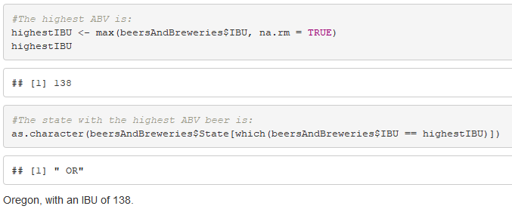
Question 5: Which state has the highest IBU?

Slide 16
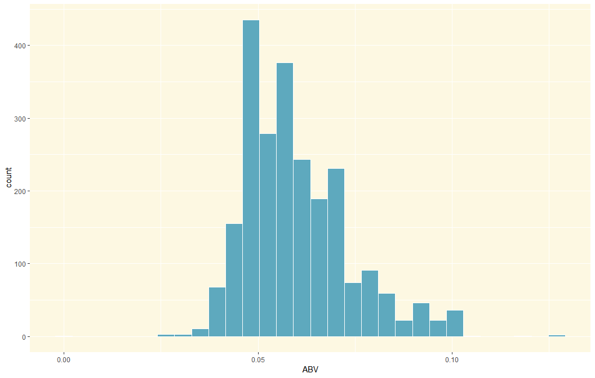
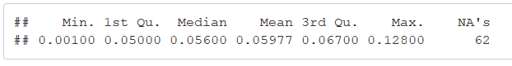
Question 6: What does ABV look like?
Summary of ABV

Slide 17
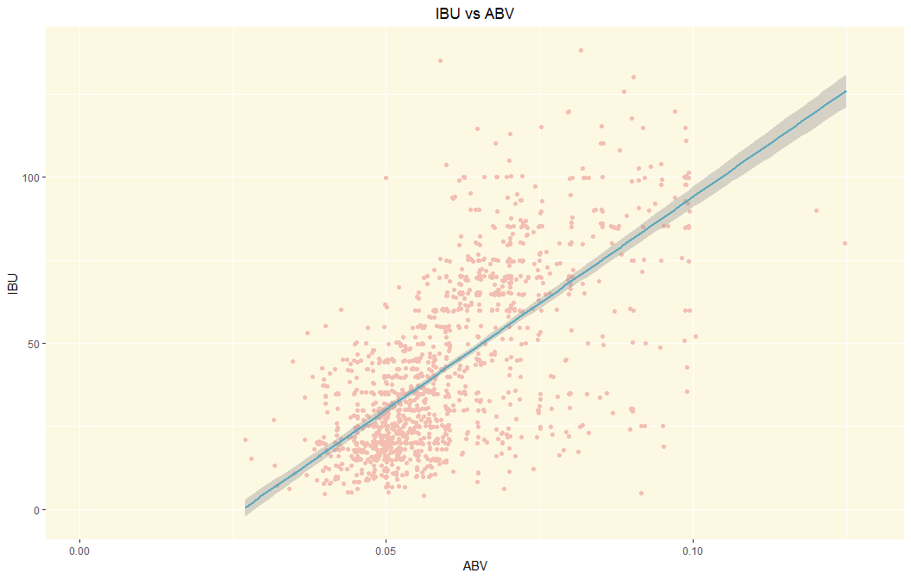
Question 7: Is there a relationship between IBU and ABV?

Slide 18

Question 7: Is there a relationship between IBU and ABV?
The Pearson correlation coefficient is 0.67, indicating a moderate correlation between IBU and ABV.

Slide 19
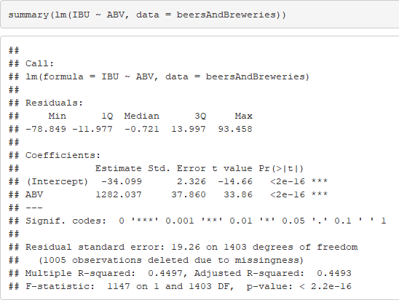


Question 7: Is there a relationship between IBU and ABV?
We fit a simple linear regression model to the data. The model that describes the relationship between ABV and IBU is:
$$IBU=−34.099+1282.037∗ABV$$
$R^{2}=.45$
$P\left(F>1147\right)<0.0001$

Slide 20
Questions?

